Slide 1
OOSd (Object Oriented Software Development)
Object Orientated overview
John Walsh

Slide 2
Overview
OO Design
Objects
Classes
Encapsulation
Inheritance
Polymorphism
OO Design
Objects & Object Characteristics
packet containing data(state) and methods (behaviours)
methods -- deliver service (update & report data/state)
message -- request to execute a method
Class
template for creating objects (defines what an object looks like)
instance -- an object that belongs to a class
Encapsulation
information hiding by objects
Inheritance
allowing the reuse of class, specialisation of class
hierarchy -- tree structure inheritance relations
Polymorphism
Ability to determine method to call at runtime (regardless of defined type)

Slide 3
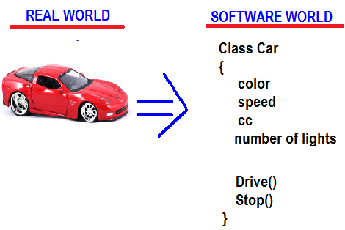
OO Design Mapping real world Object To Software Object
Q : How do you translate the real world into software ?
Software Objects (just like real world objects ) have :
State (data)
behaviour/functionality (methods i.e functions)
State : describes attribute/properties of object.
Behaviour : describes what the object can do, its functionality.
Behaviour updates the states of the object :
Drive() method updates the speed property

Slide 4
OO Design
OO Design
Objects
Classes
Encapsulation
Inheritance
Polymorphism
A software system provides a solution to a problem in the real world.
. How do you translate the real world into software ?
. Use Object Orientated design
Objects in real world Objects in software
Objects in real world
have attributes / state
car has colour, model, wheels; bank account has a balance)
have behaviours
car can drive, bank account can be credited)
Objects can be related to other objects
car object is a vehicle object, car object contains (has a) wheel object
Mapped To

Slide 5
OO Design
OO Design
Objects
Classes
Encapsulation
Inheritance
Polymorphism
Software Design using objects
When designing software system
Break up problem into objects
Define objects functionality (what it does) and data it manipulates
Each object should
Expose what it does (what functions it performs )
Hide how it does it
Objects can then call other objects, ask them to do something (not caring how they do it)
E.G Person object -> tells Car object to turn left -> tells wheel objects to turn left

Slide 6
Features
OO Design
Objects
Classes
Encapsulation
Inheritance
Polymorphism
Features of OOP
Encapsulation / information hiding
state, autonomous behavior
data abstraction
emphasis on what rather than how
inheritance
incremental changes, specialization, reusability
dynamic binding
binding at runtime, polymorphism , virtual functions

Slide 7
Objects
OO Design
Objects
Classes
Encapsulation
Inheritance
Polymorphism
Definition
An object is an entity that has a state and a defined set of operations which operate on that state. The state is represented as a set of object attributes. The operations associated with the object provide services to other objects (clients) which request these services when some computation is required.
Objects are created according to some object class definition. An object class definition serves as a template for objects. It includes declarations of all the attributes and services which should be associated with an object of that class.
Ian Sommerville 2004 (Software Engineering, 7th edition. Chapter 14)

Slide 8
Objects Characteristics
OO Design
Objects
Classes
Encapsulation
Inheritance
Polymorphism
An object contains both data and methods that manipulate that data
It contains state (e.g. car has a color) and behavior (e.g. car can be driven)
The data represents the state of the Object
An object is responsible for its own data
But: it can expose that data to other objects
Data can also be another object
Data can describe the relationships between this object and other objects
Example: A Checking Account might have
A balance (the internal state of the account)
An owner (some object representing a person)
Objects are independent and encapsulate state and representation information.
Good for maintenance. Objects may be understood as stand-alone entities.
Makes them reusable components.
System functionality is expressed in terms of object services.
Shared data areas are eliminated. Objects communicate by message passing.

Slide 9
Object communication
OO Design
Objects
Classes
Encapsulation
Inheritance
Polymorphism
Conceptually, objects communicate by message passing.
Messages
The name of the service requested by the calling object;
Copies of the information required to execute the service and the name of a holder for the result of the service.
In practice, messages are often implemented by procedure/method calls
Name = procedure name;
Information = parameter list

Slide 10
Classes
OO Design
Objects
Classes
Encapsulation
Inheritance
Polymorphism
A class is a blueprint or prototype from which objects are created (describes a object type)
Class is the definition : Object is the actual crated entity (instance)
Classes describe objects
Every object belongs to (is an instance of) a class
• An object may have fields, or variables
The class describes those fields
• An object may have methods
The class describes those methods
A class is like a template, or cookie cutter
A class has a constructor for creating objects

Slide 11
Classes versus objects
OO Design
Objects
Classes
Encapsulation
Inheritance
Polymorphism
A class is a description only
blueprint, template, recipe, instruction sheet on how to create objects
Objects are things that are created based on the class instruction sheet
There is only ever 1 class
(ie 1 description)
Can have infinite number of object,
all created from class description
Class
{
//properties
//methods
}
Object 1
-contains values, state
Object 2
-contains values, state
Object 3
-contains values, state

Slide 12
Example of a class
OO Design
Objects
Classes
Encapsulation
Inheritance
Polymorphism
class Employee
{
// fields
String name;
double salary;
//Constructor
public Employee (string n, double s){
name = n;
salary = s
}
// a method
void pay () {
Console.Writeln ("Pay to the order of " +
name + " $" + salary);
}
}

Slide 13
Encapsulation
OO Design
Objects
Classes
Encapsulation
Inheritance
Polymorphism
Encapsulation (hiding innards of class)
Restrict access to objects components (data and behaviour)
only the object itself can directly access or manipulate its data
does not expose data directly (data hiding) but exposes methods that safely manipulate internal data
Prevents unauthorized use of internal data => Protects object from inadvertent changes
communicate with object only through well-defined message passing (ie methods and parameters)

Slide 14
Encapsulation – Benefits
OO Design
Objects
Classes
Encapsulation
Inheritance
Polymorphism
Object is black box : focuses on What rather than how
separate an object's implementation from its behavior
any changes to the internal implementation is transparent to the user of that object
Makes it easier/more reliable to build software
Can change internal implementation of object without breaking things
Can connect software object together with more ocnfidence
Promotes reusability via loose coupling
Loose coupling : object is autonomous black box
If object changes internally, this has no knock-on effect on other objects
limit the interdependencies between software components.

Slide 15
Inheritance
OO Design
Objects
Classes
Encapsulation
Inheritance
Polymorphism
Inheritance provides a powerful and natural mechanism for organizing and structuring your software.
Different kinds of objects often have a certain amount in common with each other
Cars, busses, motorbikes for example, all share the characteristics of Vehicles (speed, number of wheels, seats).
Yet each also defines additional features that make them different : motorbikes has 2 wheels, car has 4; car has a boot, motorbike has handlebars
Object-oriented programming allows classes to inherit commonly used state and behavior from other classes
Vehicle becomes the baseclass (superclass)
Defines features of a vehicle
Motorbike & car can inherit features of the vehicle
features that are common to all vehicles, speed, ability to drive etc..
Motorbike & car can define specialisations
feature that are unique to them and not common to other vehicles; a bike has handlebars
Can have inheritance tree, where class inherits from class, which inherits from class
Eg. Racing Car inherits from a car inherits from a vehicles

Slide 16
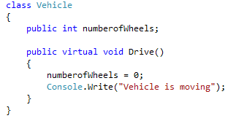
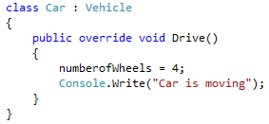
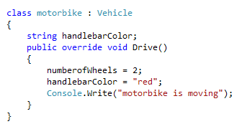
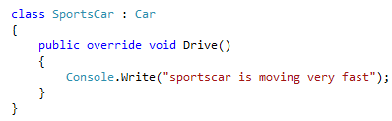
Inheritance tree
OO Design
Objects
Classes
Encapsulation
Inheritance
Polymorphism

Slide 17
Polymorphism
OO Design
Objects
Classes
Encapsulation
Inheritance
Polymorphism
When a program call a method through a baseclass variable, the correct subclass version of the method is called, based on the type of the reference stored in the superclass variable
Lets say I create a animal object , with a makesound() method
I then create dog and cat object (that are subclasses of animal and contains their own makesound methods)
I can reference dog and cat as animal objects
If i call the makesound method on these object (using animal reference) the correct method will be called
In short :
I created a bunch of animal objects (that are dogs and cats)
the dog makesound method will be called for the dog object
the cat makesound method will be called for the cat object

Slide 18
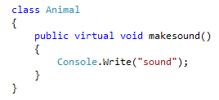
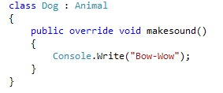

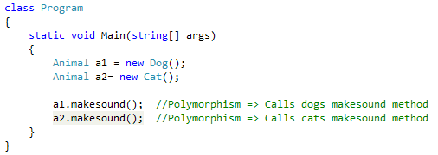
Polymorphism
OO Design
Objects
Classes
Encapsulation
Inheritance
Polymorphism
Base Class : animal
Subclass : Dog
Subclass : Cat

Slide 19
Benefits of using OO design
Modularity
autonomous entities, cooperation through exchanges of well defined messages (contract programming)
The source code for an object can be written and maintained independently of the source code for other objects. Once created, an object can be easily passed around inside the system.
Information-hiding (encapsulation):
By interacting only with an object's methods, the details of its internal implementation remain hidden from the outside world.
the internal workings of an object can be redefined without changing other parts of the system (because focus on what rather than how)
Code re-use
If an object already exists (perhaps written by another software developer), you can use that object in your program. This allows specialists to implement/test/debug complex, task-specific objects, which you can then trust to run in your own code.
refining classes through inheritance
Pluggability and debugging ease
If a particular object turns out to be problematic, you can simply remove it from your application and plug in a different object as its replacement. This is analogous to fixing mechanical problems in the real world. If a bolt breaks, you replace it, not the entire machine.
Naturalness
Map real world object to software objects (object-oriented analysis/design,modeling)

Slide 20
Resources
http://docs.oracle.com/javase/tutorial/java/concepts/index.html
www.cc.ee.ntu.edu.tw/~farn/courses/SE/ch14.ppt
www.cis.upenn.edu/~matuszek/cit591.../object-concepts.ppt

